Slide 1
Lecture 14: Network Security （Transport Layer）
An Introduction to Information Security
School of Big Data and Software Engineering, CQU
Fall, 2018

Slide 2
Quickly Review
Review
Digital Signature
Authentication Protocol
Kerberos
Pretty Good Privacy

Slide 3
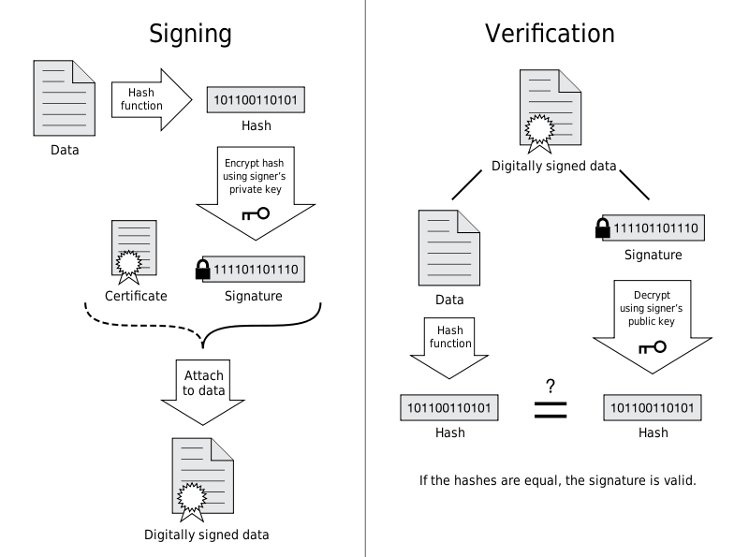
1.Digital Signature

Slide 4




2 Authentication Protocols
AS: Authentication Server
E(K_{AS,C}, (K_{C,TGS} || ID_{TGS} || ID_{tgs}|| TS2 || Lifetime2 || Ticket_{TGS}
2
ID_{c} || ID_{tgs}|| TS1
1
3
4
TGS: Ticket Granting Server
5
C: Client
6
V: Application Server
Kerberos v4

Slide 5
3. Pretty Good Privacy
N-bit
session
key
M
SHA-1
RSA
RSA
M
C
AES
Internet
RSA
C
N-bit
session
key
RSA
M
AES
SHA-1

Slide 6

Outline
1. About Network Security
2. SSL & TLS
3. Wireshark Case for TLS1.2

Slide 7
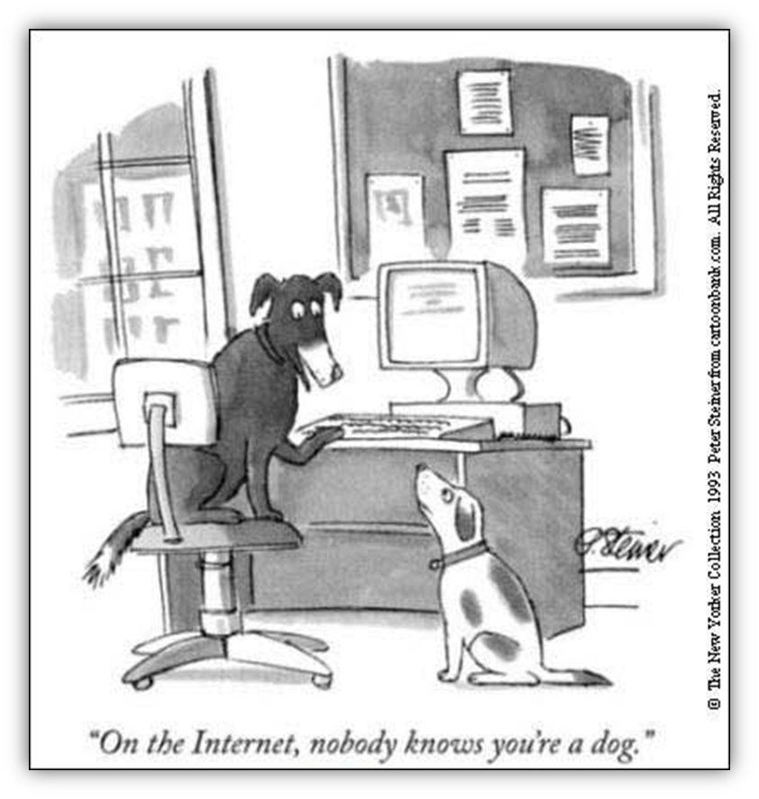
1. About Network Security
Web now widely used by
business, government, individuals
but Internet & Web are vulnerable
HTTP upon TCP/IP
Why?
（open，inter-connect， gentleman agreement…）
have a variety of threats
integrity
confidentiality
denial of service
authentication
need added security mechanisms
Where/ How to add SM?

Slide 8
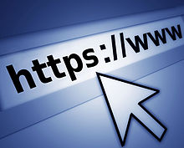
1. About Network Security
How to Secure the Network?
安全的应用程序
应用层
安全的应用层协议
S/MIME,PGP,SET…
SSL/TLS
传输层
网络层
IPSEC
链路层
Link Encryption
物理层

Slide 9
Outline
1. About Network Security
2. SSL & TLS
3. Wireshark Case for TLS1.2

Slide 10

2. SSL/TLS
SSL: Secure Socket Layer
Ver. 1-3
originally developed by Netscape
uses TCP to provide a reliable and secure end-to-end service
SSL is below Application Layer and Upon Transport Layer
SSL has two layers of four protocols
TLS: Transport Layer Security
Ver. 1.1-1.2
TLS is successor of SSL
Became Internet Standard (RFC 2246 )
HTTP
SMTP
……
SSL/TLS
TCP / UDP

Slide 11
2. SSL/TLS
SSL/TLS Provide services:
Fragmentation
Compression
Message Integrity
Confidentiality
Framing
……
Security Mechanisms
MAC/HMAC, Digital Signature
Key Exchange, Symmetric Key Encryption
Public Key Encryption

Slide 12
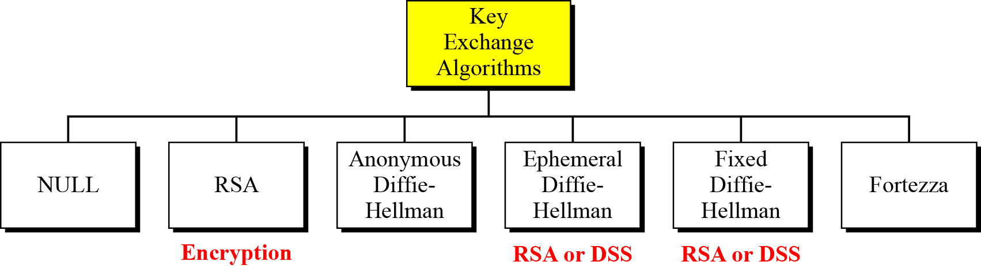
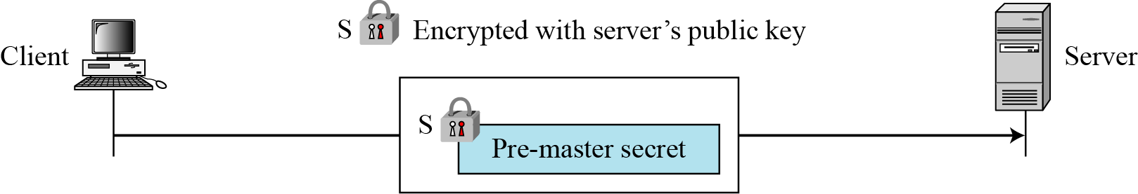
2. SSL/TLS
SSL/TLS Security Mechanisms
Key Exchange: make client and server sharing a session Key

Slide 13
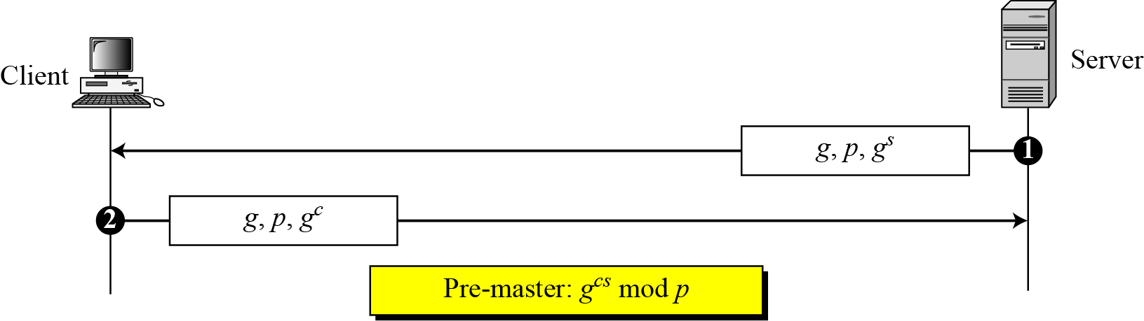
2. SSL/TLS
SSL/TLS Security Mechanisms
Key Exchange: make client and server sharing a session Key

Slide 14
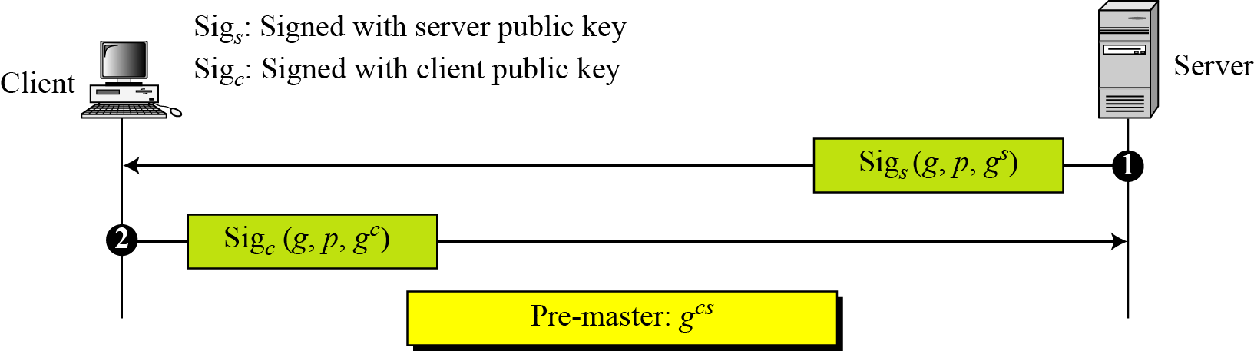
2. SSL/TLS
SSL/TLS Security Mechanisms
Key Exchange: make client and server sharing a session Key

Slide 15
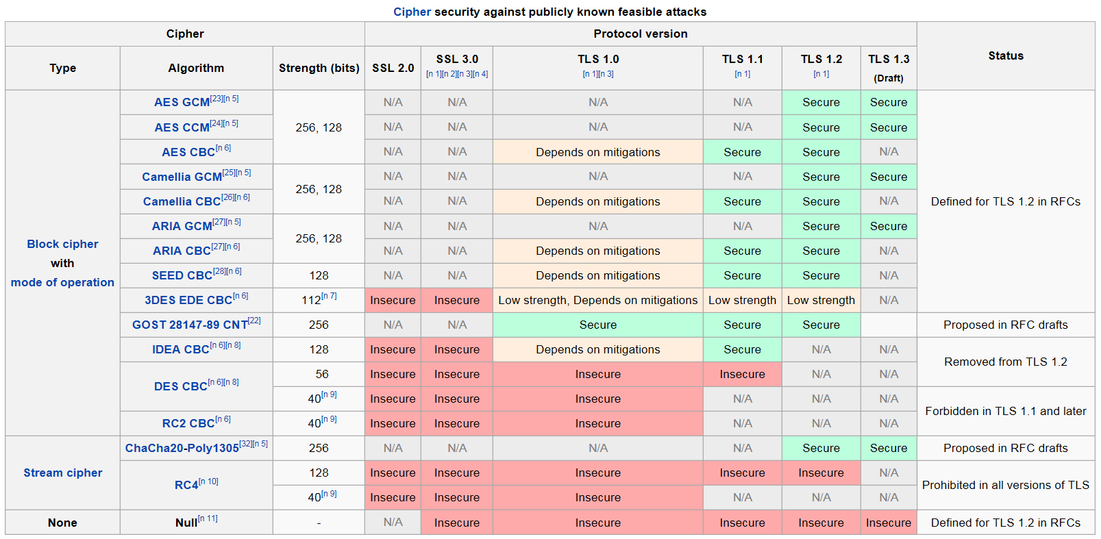
2. SSL/TLS
SSL/TLS Security Mechanisms
Key Exchange: make client and server sharing a session Key
Symmetric Encryption/decryption algorithms: confidentiality

Slide 16
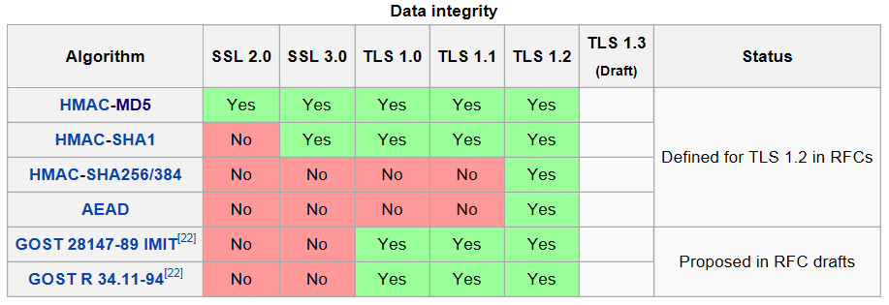
2. SSL/TLS
SSL/TLS Security Mechanisms
Key Exchange: make client and server sharing a session Key
Symmetric Encryption/decryption algorithms: confidentiality
Hash Functions：message integrity

Slide 17
2. SSL/TLS
SSL/TLS Architecture
2 Layers
4 Protocols
SSL/TLS
Handshaking
Change Cipher Specification
Alert
HTTP, SMTP, FTP…
SSL/TLS Record Protocol
Transport Layer
IP Layer

Slide 18
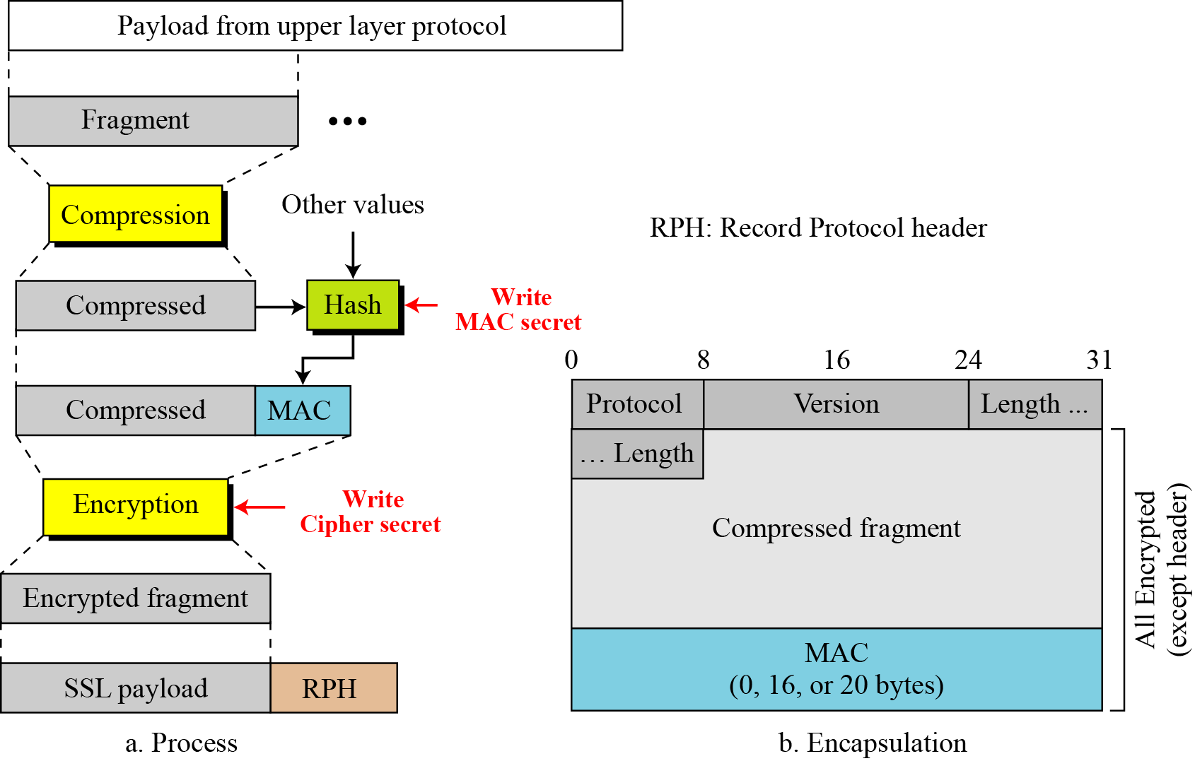
2. SSL/TLS
SSL/TLS Record Protocol
Q1: what security service does it provide?
Q2: How to agree with a session key and HMAC algorithm？
Integrity
Confidentiality
Handshaking!

Slide 19
2. SSL/TLS
SSL/TLS Handshake Protocol
Q2: How to agree with a session key and HMAC algorithm？
allows server & client to:
authenticate each other
to negotiate encryption & MAC algorithms
to negotiate cryptographic keys to be used
comprises a series of messages in phases
Establish Security Capabilities
Server Authentication and Key Exchange
Client Authentication and Key Exchange
Finish

Slide 20
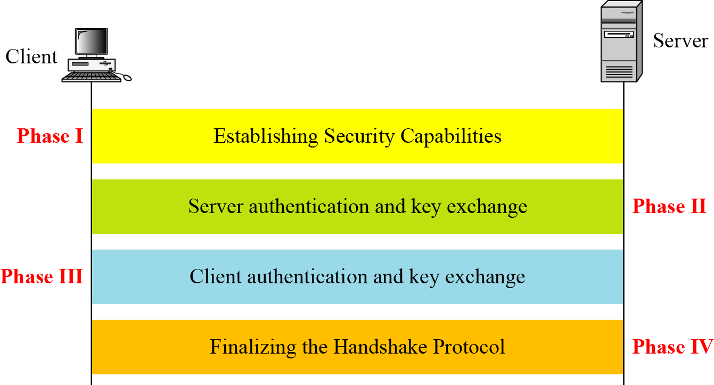
2. SSL/TLS
SSL/TLS Handshake Protocol
Q2: How to agree with a session key and HMAC algorithm？
Four Step of handshaking

Slide 21
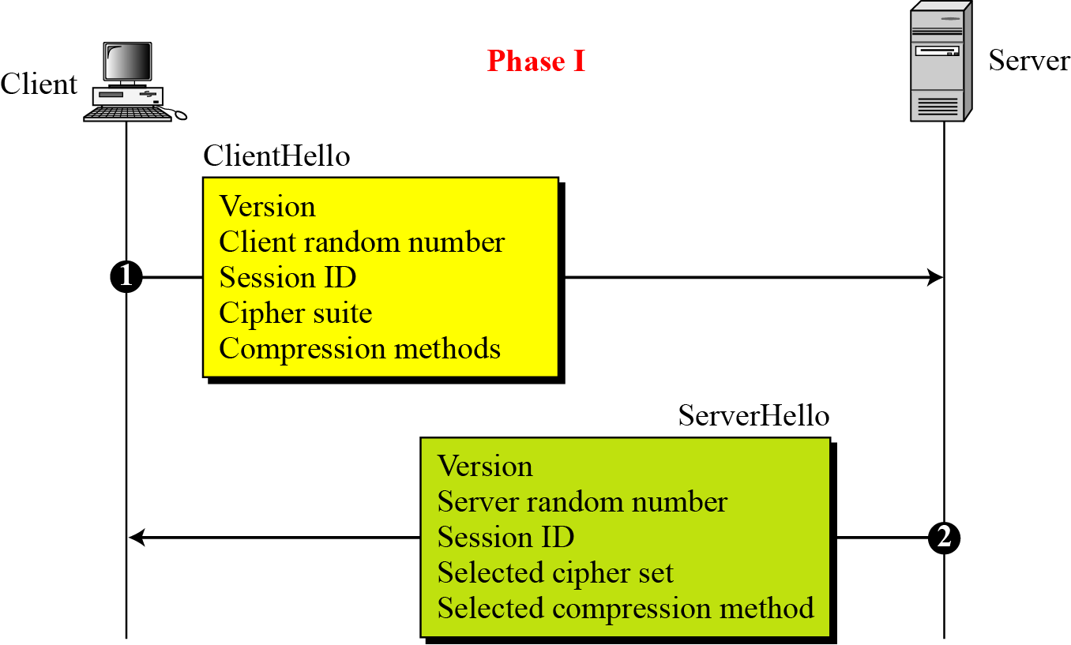
2. SSL/TLS
SSL/TLS Handshake Protocol
Q2: How to agree with a session key and HMAC algorithm？
Four Step of handshaking
Step I : client hello & sever hello

Slide 22
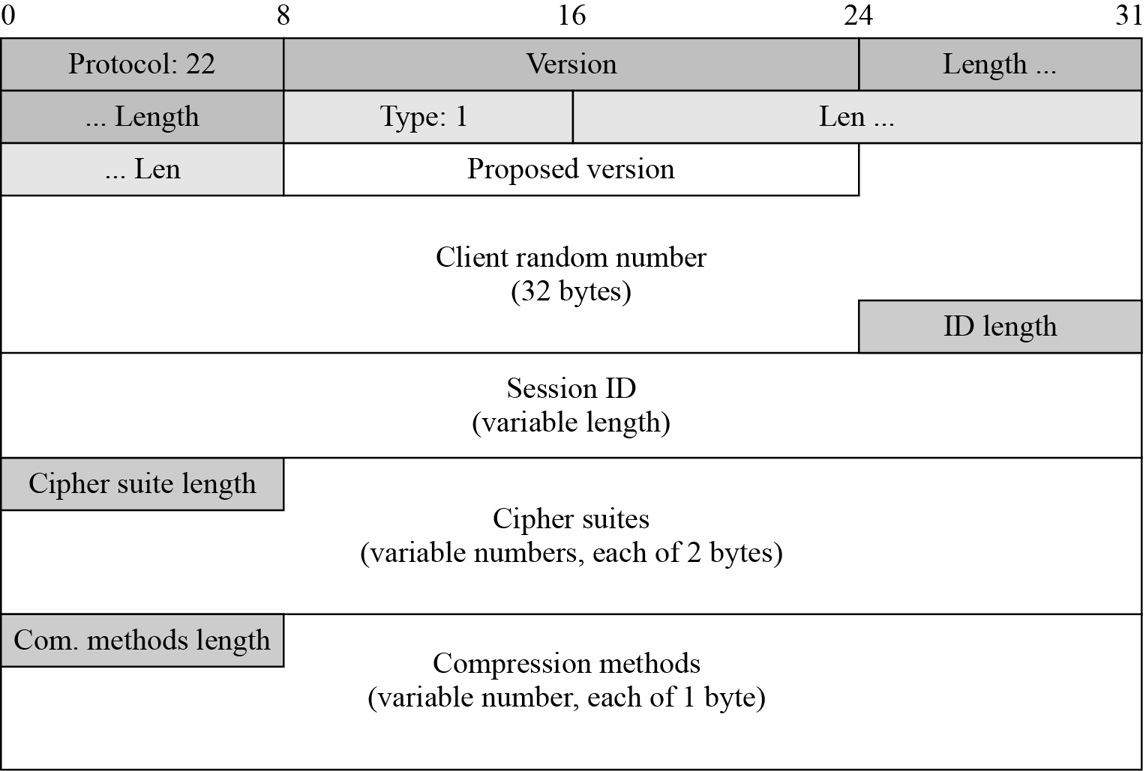
2. SSL/TLS
SSL/TLS Handshake Protocol
Q2: How to agree with a session key and HMAC algorithm？
Four Step of handshaking
Step I : client hello & sever hello message

Slide 23
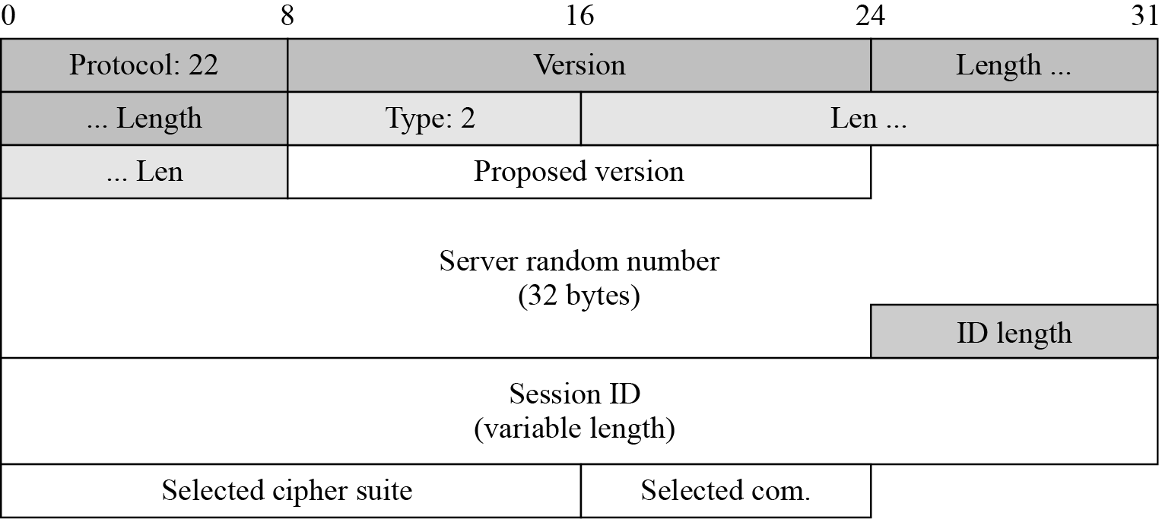
2. SSL/TLS
SSL/TLS Handshake Protocol
Q2: How to agree with a session key and HMAC algorithm？
Four Step of handshaking
Step I : client hello & sever hello message

Slide 24
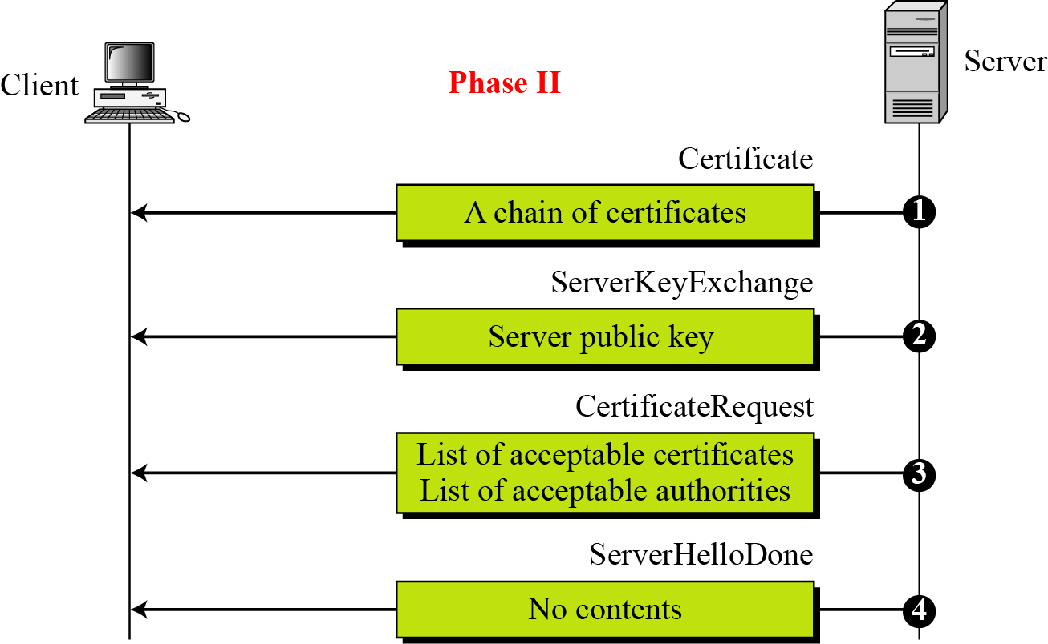
2. SSL/TLS
SSL/TLS Handshake Protocol
Q2: How to agree with a session key and HMAC algorithm？
Four Step of handshaking
Step II: Server authentication and key exchange

Slide 25
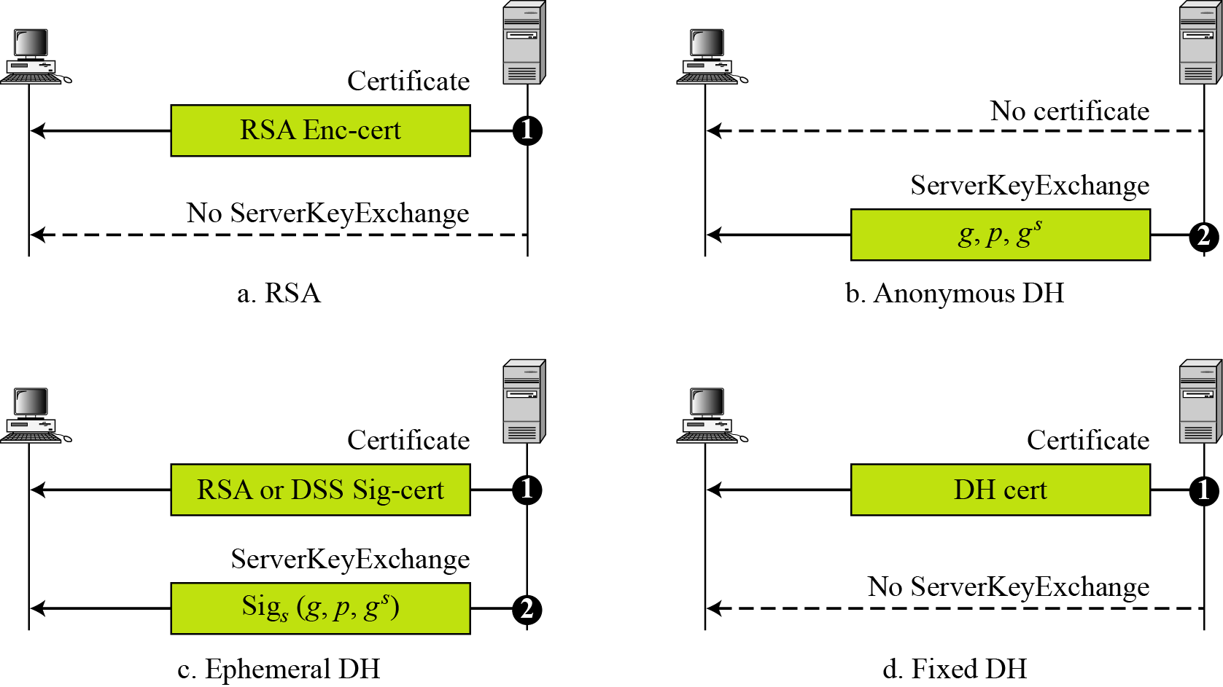
2. SSL/TLS
SSL/TLS Handshake Protocol
Q2: How to agree with a session key and HMAC algorithm？
Four Step of handshaking
Step II: Server authentication and key exchange

Slide 26
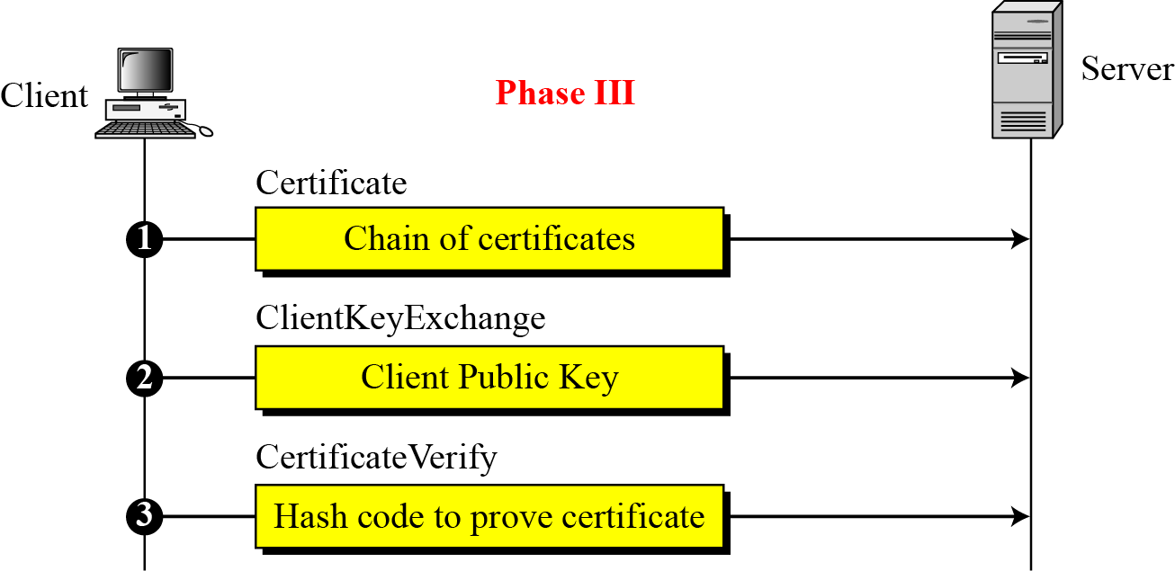
2. SSL/TLS
SSL/TLS Handshake Protocol
Q2: How to agree with a session key and HMAC algorithm？
Four Step of handshaking
Step III: Client authentication and key exchange

Slide 27
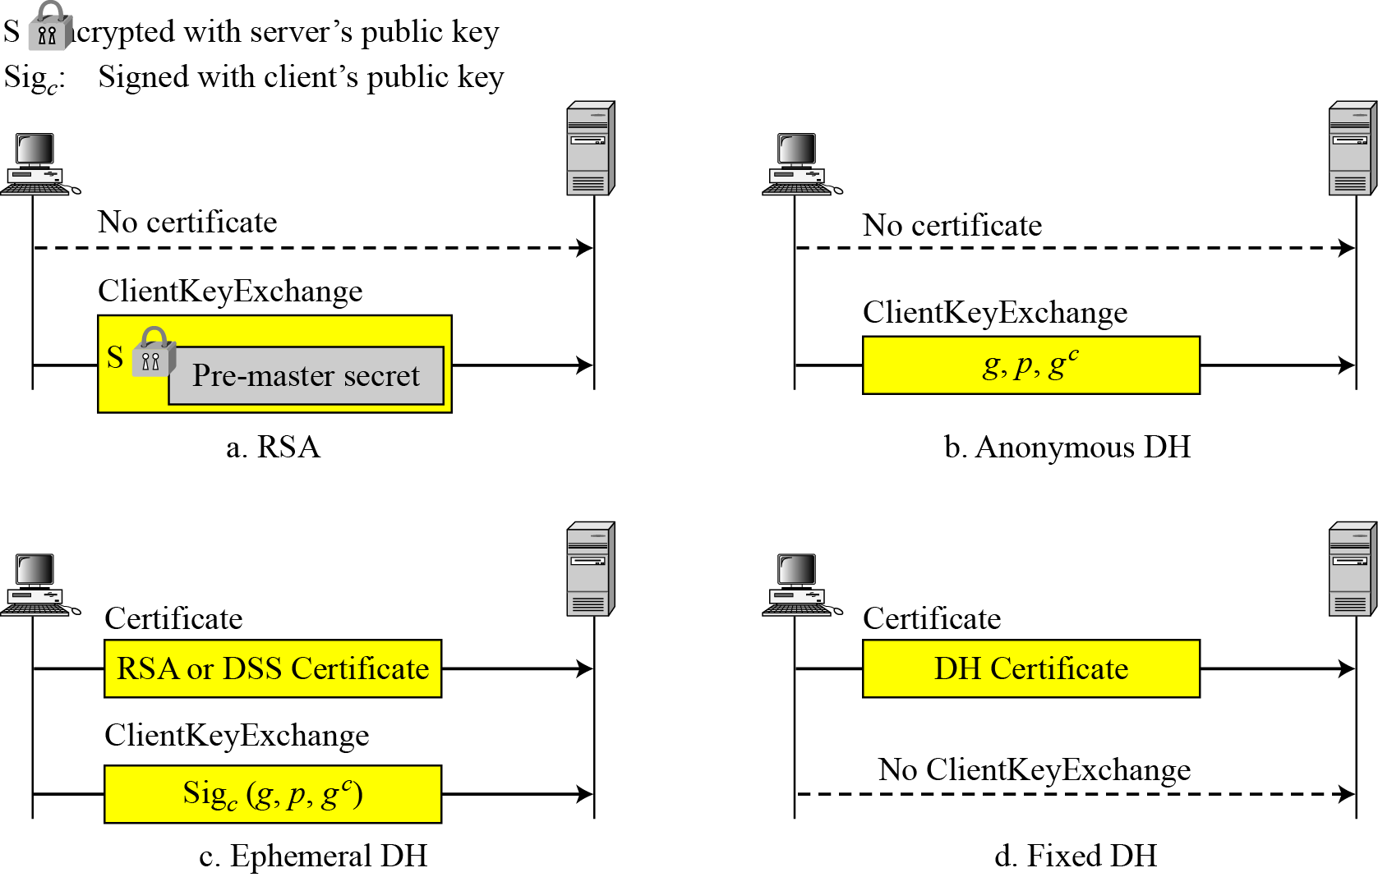
2. SSL/TLS
SSL/TLS Handshake Protocol
Q2: How to agree with a session key and HMAC algorithm？
Four Step of handshaking
Step III: Client authentication and key exchange

Slide 28
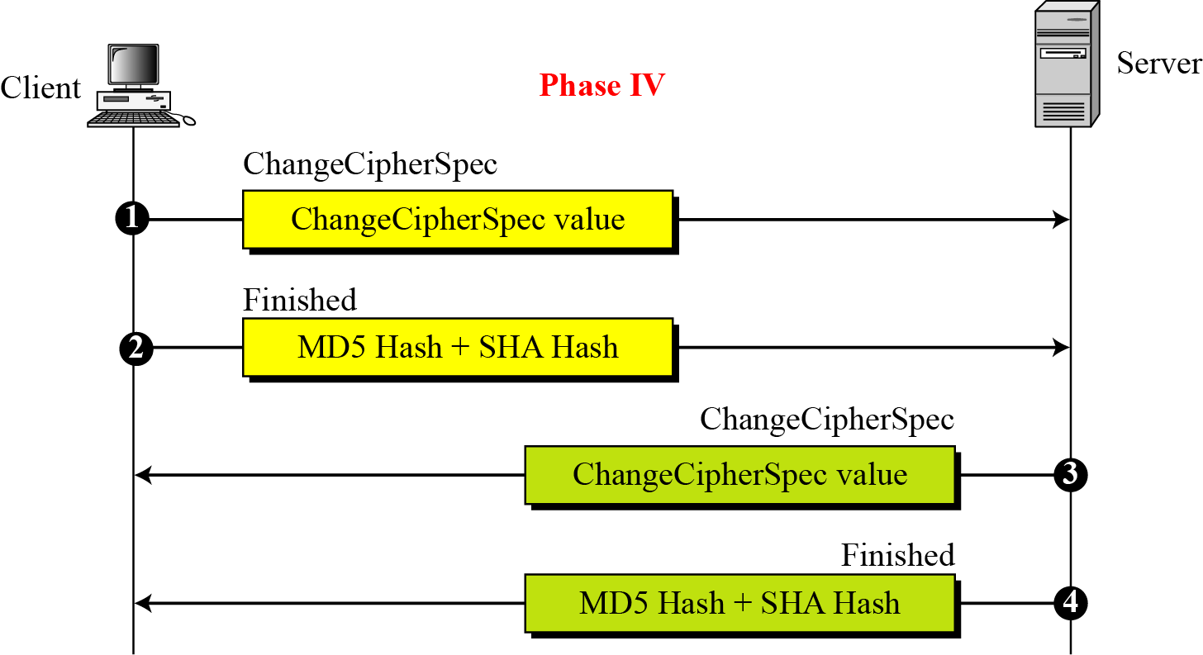
2. SSL/TLS
SSL/TLS Handshake Protocol
Q2: How to agree with a session key and HMAC algorithm？
Four Step of handshaking
Step IV: Finalizing the handshaking

Slide 29
Outline
1. About Network Security
2. SSL & TLS
3. Wireshark Case for TLS1.2

Slide 30


3. Wireshark Lab for TLS1.2
Protocol and Tools
POP3 and SMTP over TCP
POP3
Port 110
SMTP
Port 25
SYN 25 / 110
SYN ACK
ACK
POP/SMTP Hello
Transport Layer
POP/SMTP Hello
……
IP Layer

Slide 31
3. Wireshark Lab for TLS1.2
Protocol and Tools
POP3 and SMTP over TLS
POP3
Port 995
SMTP
Port 465
SYN 995/ 465
SYN ACK
TLS
ACK
TLS Client Hello
Transport Layer
TLS Server Hello
TLS Server Auth.
TLS Client Auth.
IP Layer
TLS Client Cipher. Speci
TLS Server Cipher Speci.
Secure POP/SMTP
Secure POP/SMTP

Slide 32
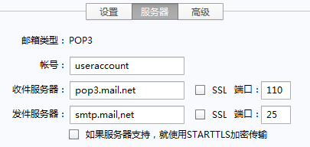
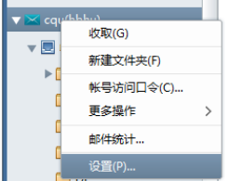
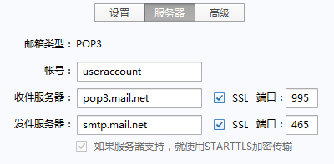
3. Wireshark Lab for TLS1.2
Protocol and Tools
POP3 and SMTP
Mail Agent: Foxmail 7.x
POP/SMTP over TCP
POP/SMTP over TLS

Slide 33
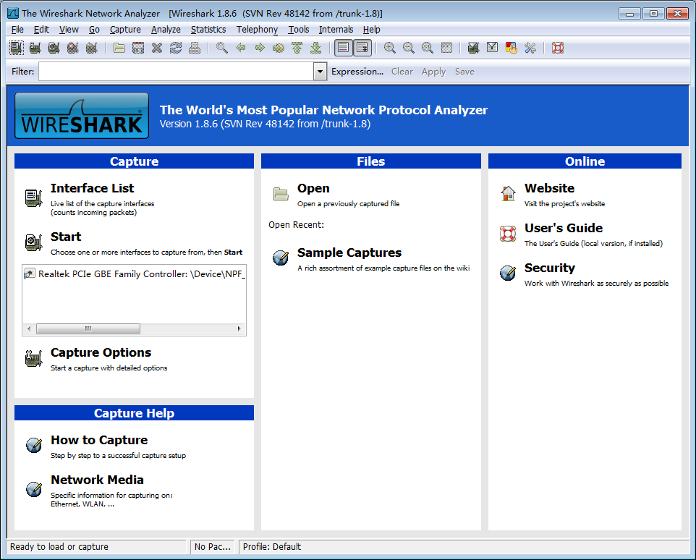
3. Wireshark Lab for TLS1.2
Protocol and Tools
POP3 and SMTP
Mail Agent: Foxmail 7.x
Wireshark

Slide 34
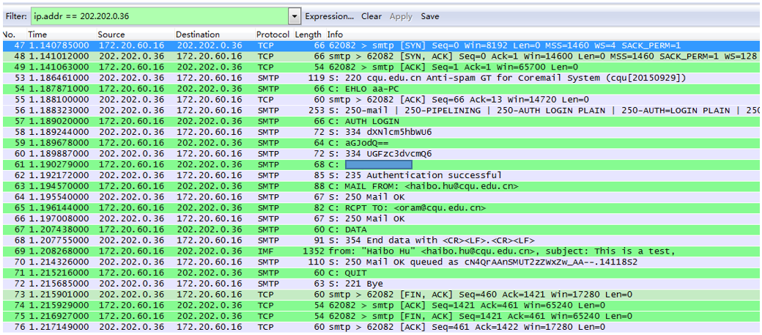
3. Wireshark Lab for TLS1.2
Protocol and Tools
POP3 and SMTP
Mail Agent: Foxmail 7.x
Wireshark Results: SMTP over TCP
TCP SYN
Risky
SMTP
TCP FIN

Slide 35
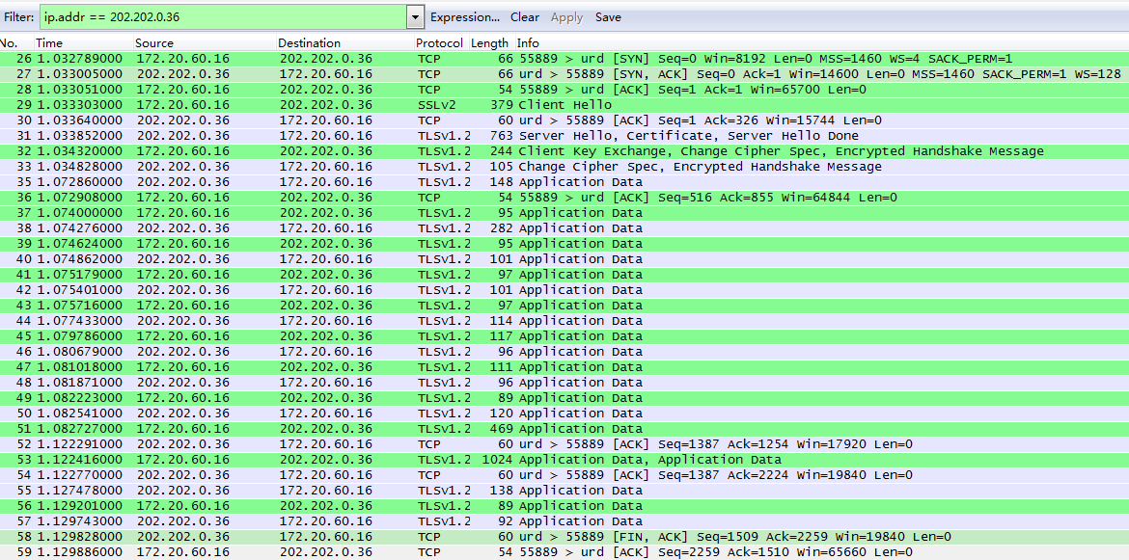
3. Wireshark Lab for TLS1.2
Protocol and Tools
POP3 and SMTP
Mail Agent: Foxmail 7.x
Wireshark Results: SMTP over TLS
TCP SYN
TLS
Handshaking
Secured
SMTP

Slide 36
Lecture 6: Advanced Encryption Standard （AES）
Summary
Network Security
Internet is risky for Communications
SSL/TLS
A mid-layer to secure TCP/IP
SSL/TLS has 2 sub-layers, with 4 protocols
Handshake, Change Cipher Spec., Alert,
Record
Handshake Protocol
Agree on cryptographic parameters
SSL/TLS Wireshark Lab on POP3/SMTP

Slide 37
An Introduction to Information Security
Thanks for your attention!
Q&A

